Slide 2
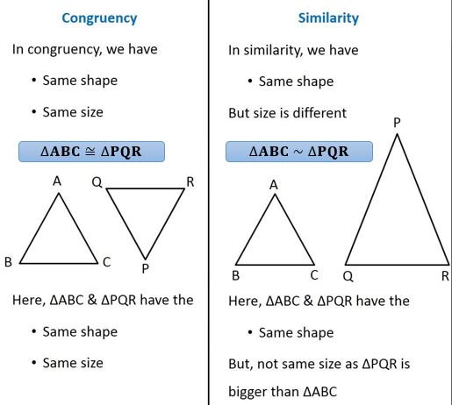
CONGRUENCY AND SIMILARITY
All sides and angles are equal.
All sides and angles are proportional

Slide 3
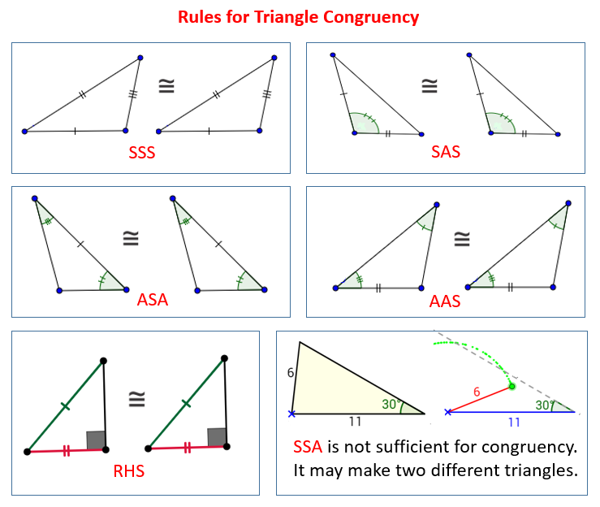

Slide 4
